Slide 1
PROJECT I
My professional profile

Slide 2
CONTENTS OF THE PROJECT
CV / RESUME | Creating the CV / resume
COVER LETTER | To introduce yourself
LINKEDIN | To make public your profile (optional)
JOB OFFER | Imagine you are applying to a job offer
JOB INTERVIEW | Let’s face an interview

Slide 3
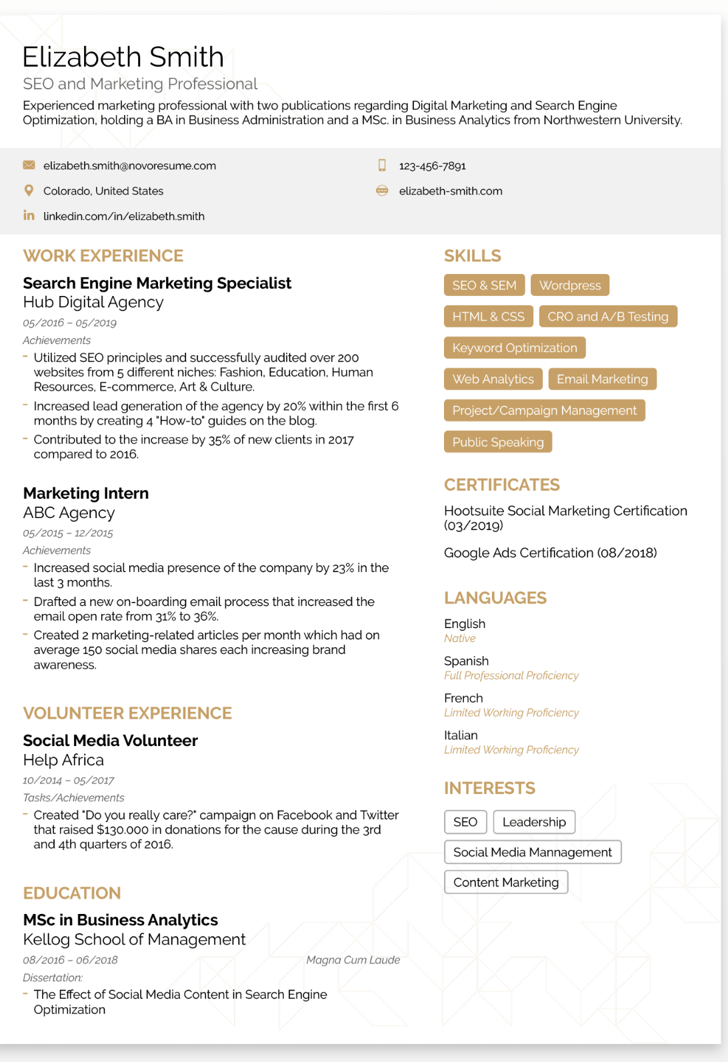
CV / RESUME - importance
The CV / resume acts as a bridge between you and the prospective recruiter. Hence the importance of a resume can never be underestimated. So, to make the first impression, it is imperative that your CV / resume stands out from the crowd first.
It is up to you how do you want to be remembered by the hiring manager. Since companies do not have that much amount of time to interview each and every candidate, they require CVs / resumes from candidate to select the best ones to work with them.

Slide 4
CV / RESUME - structure
PERSONAL INFORMATION
EDUCATION AND TRAINING
CV SUMMARY/ OBJECTIVE
LANGUAGE SKILLS
WORK EXPERIENCE
HARD & SOFT SKILLS

Slide 5






CV / RESUME - structure
PERSONAL INFORMATION
NAME, SURNAME
JOB TITLE
EMAIL
WEB /SOCIAL MEDIA
*As long as they’re relevant.
LOCATION
(NO COMPLETE ADDRESS)
Valencia, Spain
NO PICTURE!!!!!
PHONE NUMBER

Slide 6
CV / RESUME - structure
CV SUMMARY/ OBJECTIVE
Your CV summary or objective is your attempt at an important first impression. Make sure the language you use is clear, and the HR manager doesn’t have to read it a few times to understand it - because they won’t.
Even if you don’t have any work experience or education, you can still use a resume objective to stand out from the rest of the applicants.
In this case, you’d want to focus on your best personal traits and skills (instead of work experience / achievements / education).
“Information Technology student seeking a part-time role as a Technical Support Specialist at XYZ Inc. Experienced in using help desk & CRM systems. Skilled in written communication with an intermediate knowledge in the IT-sphere.”
https://novoresume.com/career-blog/resume-objective-examples

Slide 7
CV / RESUME - structure
WORK EXPERIENCE
JOB
INTERNSHIP
COMPANY
DURATION
JOB POSITION
RESPONSIBILITIES OR TASKS YOU DEVELOP

Slide 8
CV / RESUME - structure
EDUCATION AND TRAINING
General Certificate of Secondary Education
(GCSE) -
Educación Secundaria Obligatoria (ESO)
Example (Grado Superior)
“Certificate of Higher Education (HNC) in Marketing & Publicity.
Digitech Progresa
2024-2026
Valencia, Spain”
Name of the degree
Name of the institution
Years attended
Location of the institution
General Certificate of Education
(GCE) -
Bachillerato
Example (Bachillerato)
“General Certificate of Education.
IES La Misericordia
2022-2024
Valencia, Spain
Vocational Education and Training
(VET) -
Ciclo Formativo de Grado Medio (CFGM)
Example (Grado Medio)
“Vocational Training in Microcomputer System and Networks
IES Nº2
2022-2024
Valencia, Spain
Certificate of Higher Education (HNC) -
Ciclo Formativo de Grado Superior (CFGS)
Notes:
Afegir la web de referència i acabar amb les equivalencies

Slide 9
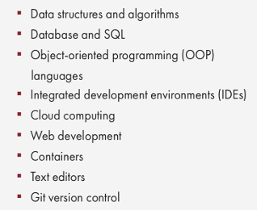
CV / RESUME - structure
HARD SKILLS
Hard skills are objective, quantifiable skills gained through training, school, or work experiences.
Not only can you learn hard skills, but you can easily prove them — for example, you either know how to write code or you don't.
Notes:
Afegir la web de referència i acabar amb les equivalencies

Slide 10
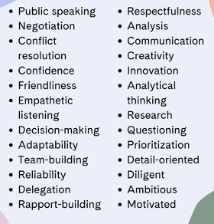
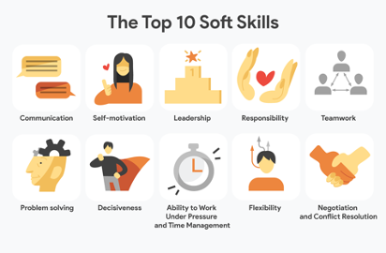
CV / RESUME - structure
SOFT SKILLS
Character traits and interpersonal skills that characterize a person’s relationships with other people. In the workplace, soft skills are considered to be a complement to hard skills.
Notes:
Afegir la web de referència i acabar amb les equivalencies

Slide 11
CV / RESUME - structure
BREVITY
No more than one or two pages.
Write short sentences.
ATTRACTIVE DESIGN
Be original and elegant.
(Canva, Flaticon…)
SINCERITY
Don’t lie!
https://www.youtube.com/shorts/gW_hJJVLCI8
ADAPT YOUR CV / RESUME
Adapt the information you share to the job you are applying for.
Notes:
Afegir la web de referència i acabar amb les equivalencies

Slide 12
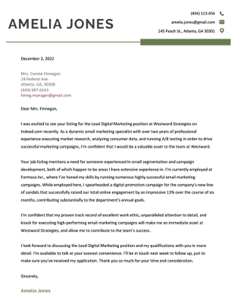
COVER LETTER - importance
It is a document you send with your CV / resume that provides additional information about skills and experiences related to the job you're applying for.

Slide 13
COVER LETTER - structure
PRESENTATION
Introduce yourself.
Show your interest in the job position.
LIFE SUMMARY
Explain your professional experience and your academic training.
SKILLS
Describe those skills you have that perfectly fit with the company values.
CLOSING LINES
Make them aware you are waiting for their answer
Goodbye!
https://novoresume.com/career-blog/how-to-write-a-cover-letter-guide

Slide 14
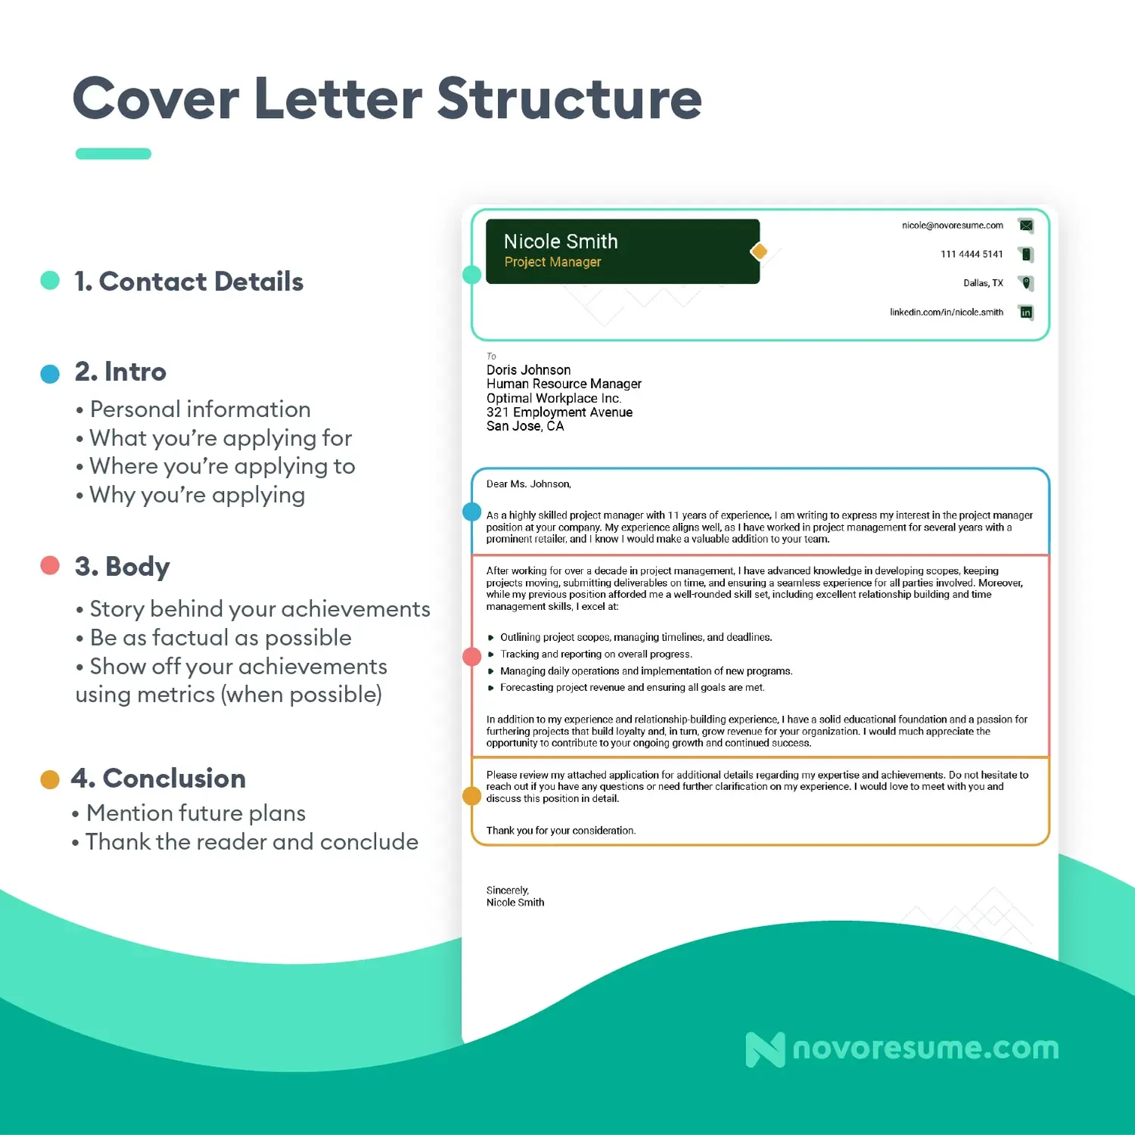
Page Count: 0.5 to 1
Word count: 250 to 400
Paragraph count: 3 to 6
https://novoresume.com/career-blog/how-to-write-a-cover-letter-guide

Slide 15
COVER LETTER - tips
BE CORDIAL AND PROFESSIONAL
Balance between friendship and formality
THE COMPANY
Look for information about the company: values, activities…
TO ADJUST
Adjust the letter to the job position
SELL YOURSELF
What can you offer to the company?
Be different, original and creative.
Notes:
Afegir la web de referència i acabar amb les equivalencies

Slide 16
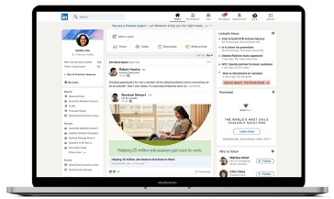
LINKEDIN
LinkedIn is the world's largest professional network on the internet. You can use LinkedIn to find the right job or internship, connect and strengthen professional relationships, and learn the skills you need to succeed in your career.

Slide 17

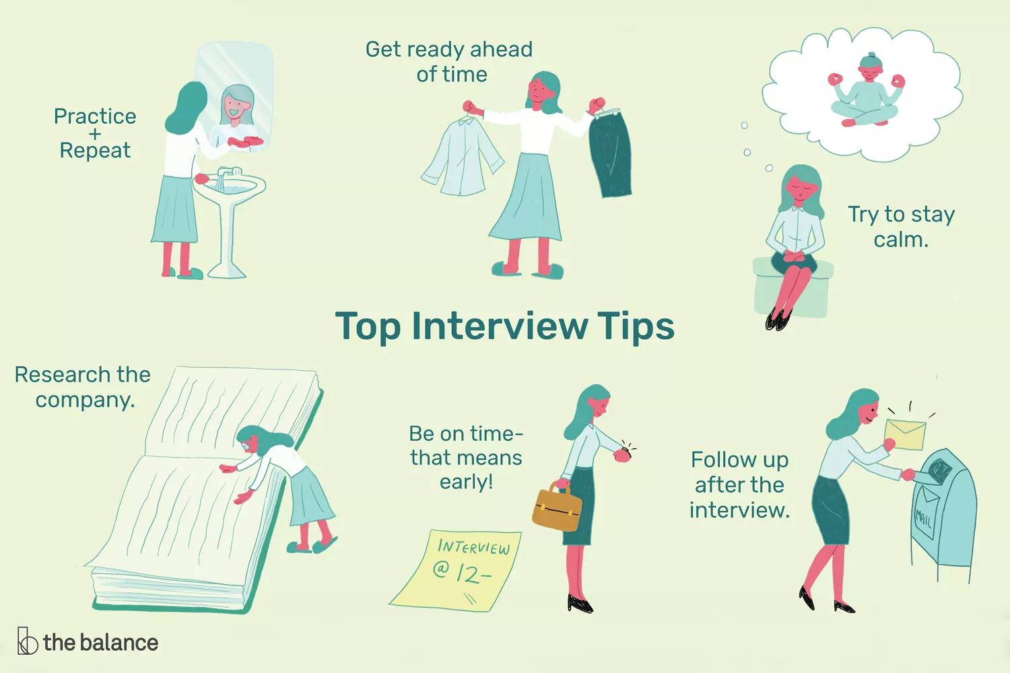
JOB INTERVIEW
https://www.youtube.com/watch?v=OWoxO4mn9uY
https://www.youtube.com/watch?v=b5l14b6FzkU

